Slide 1
ETL: Extract, Transform, Load
Lesson 13.1

Slide 2
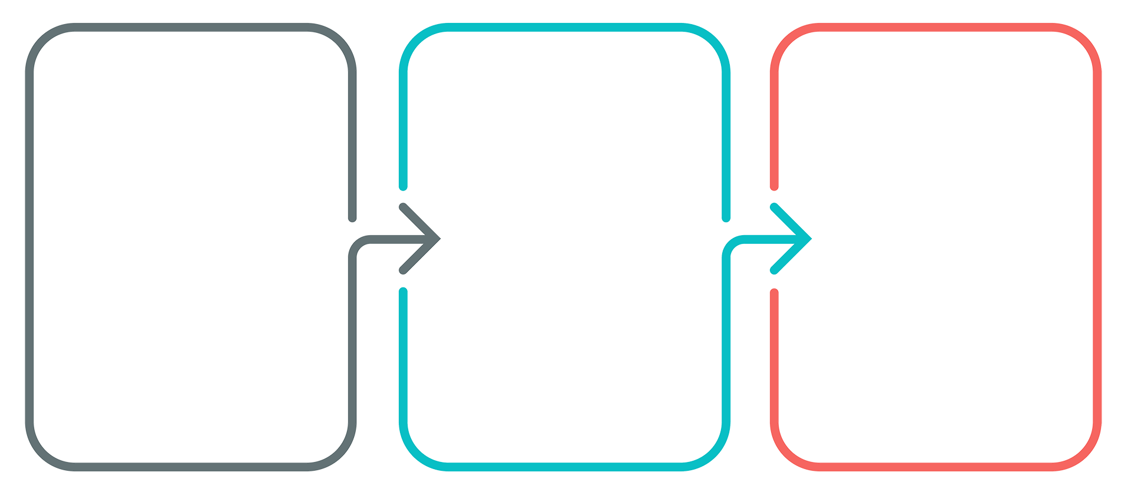
ETL
Data integration is an important part of working with data.
Extract
Read the data, often from multiple sources.
Transform
Clean and structure the data in desired form.
Load
Write the data into a database for storage.

Slide 3





Extract
Data may come from disparate
sources, such as:
CSV files
JSON files
HTML tables
SQL databases
Spreadsheets
Extract

Slide 4
Transform
Transform the data to suit business needs.
This may include:
Data Cleaning
Summarization
Selection
Joining
Filtering
Aggregating
Transform

Slide 5
Note: We will use Python and pandas for transformation, which can also be done with SQL or a specialized ETL tool.

Slide 6
Load
Load the data into a final database that can be used
for future analysis or business use.
Can be a relational or non-relational database
Can be local or in the cloud
Can be a data lake or data warehouse
Load

Slide 7
Questions?

